Slide 1
CMSC204
Figure 1 – StateGraph
V(StateGraph) = {Oregon, Alaska, Texas, Hawaii, Vermont, NewYork, California}
E(StateGraph) = {(Alaska, Oregon), (Hawaii, Alaska), (Hawaii, Texas), (Texas, Hawaii), (Hawaii, California), (Hawaii, New York), (Texas, Vermont), (Vermont, California), (Vermont, Alaska)}
1A. Draw the directed StateGraph.
Alaska
Oregon
Vermont
Hawaii
California
Texas
New York
a. Is there a path from Oregon to any other state in the StateGraph?
No, because Oregon is not directed to any other state.
b. Is there a path from Hawaii to every other state in the graph?
Yes, in addition to the states that are accessible from Hawaii directly Oregon is accessible through Alaska and Vermont is accessible through Texas.
c. From which state(s) in the graph is there a path to Hawaii?
Texas, Hawaii (path to self)

Slide 2
V(StateGraph) = {Oregon, Alaska, Texas, Hawaii, Vermont, NewYork, California}
E(StateGraph) = {(Alaska, Oregon), (Hawaii, Alaska), (Hawaii, Texas), (Texas, Hawaii), (Hawaii, California), (Hawaii, New York), (Texas, Vermont), (Vermont, California), (Vermont, Alaska)}
a. Show the adjacency matrix that would describe the edges in the StateGraph. Store the vertices in alphabetical order
1 - edge from row to column
0 - no edge
States
Alaska
California
Hawaii
New York
Oregon
Texas
Vermont
MATRIX | Alaska | California | Hawaii | New York | Oregon | Texas | Vermont
Alaska | 0 | 0 | 0 | 0 | 1 | 0 | 0
California | 0 | 0 | 0 | 0 | 0 | 0 | 0
Hawaii | 1 | 1 | 0 | 1 | 0 | 1 | 0
New York | 0 | 0 | 0 | 0 | 0 | 0 | 0
Oregon | 0 | 0 | 0 | 0 | 0 | 0 | 0
Texas | 0 | 0 | 1 | 0 | 0 | 0 | 1
Vermont | 1 | 1 | 0 | 0 | 0 | 0 | 0
3. b. Show the adjacency lists
that would describe the edges in the StateGraph
Alaska: Adjacent to Oregon
California: None
Hawaii: Adjacent to Alaska, California, New York, and Texas
New York: None
Oregon: None
Texas: Hawaii, Vermont
Vermont: Alaska, California

Slide 3
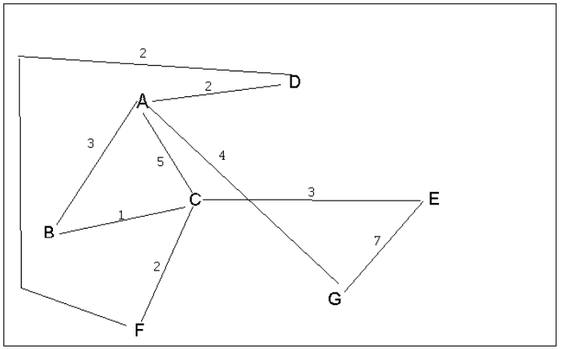
Figure 4
4 a. Which of the following lists the graph nodes (Figure 4) in depth first order beginning with E?
A) E, G, F, C, D, B, A
B) G, A, E, C, B, F, D
C) E, G, A, D, F, C, B (explore as far as possible before backtracking)
D) E, C, F, B, A, D, G
4 b. Which of the following lists the graph nodes (Figure 4) in breadth first order beginning at F?
A) F, C, D, A, B, E, G (visit all the neighbors of the current node before moving to next level)
B) F, D, C, A, B, C, G
C) F, C, D, B, G, A, E
D) a, b, and c are all breadth first traversals

Slide 4
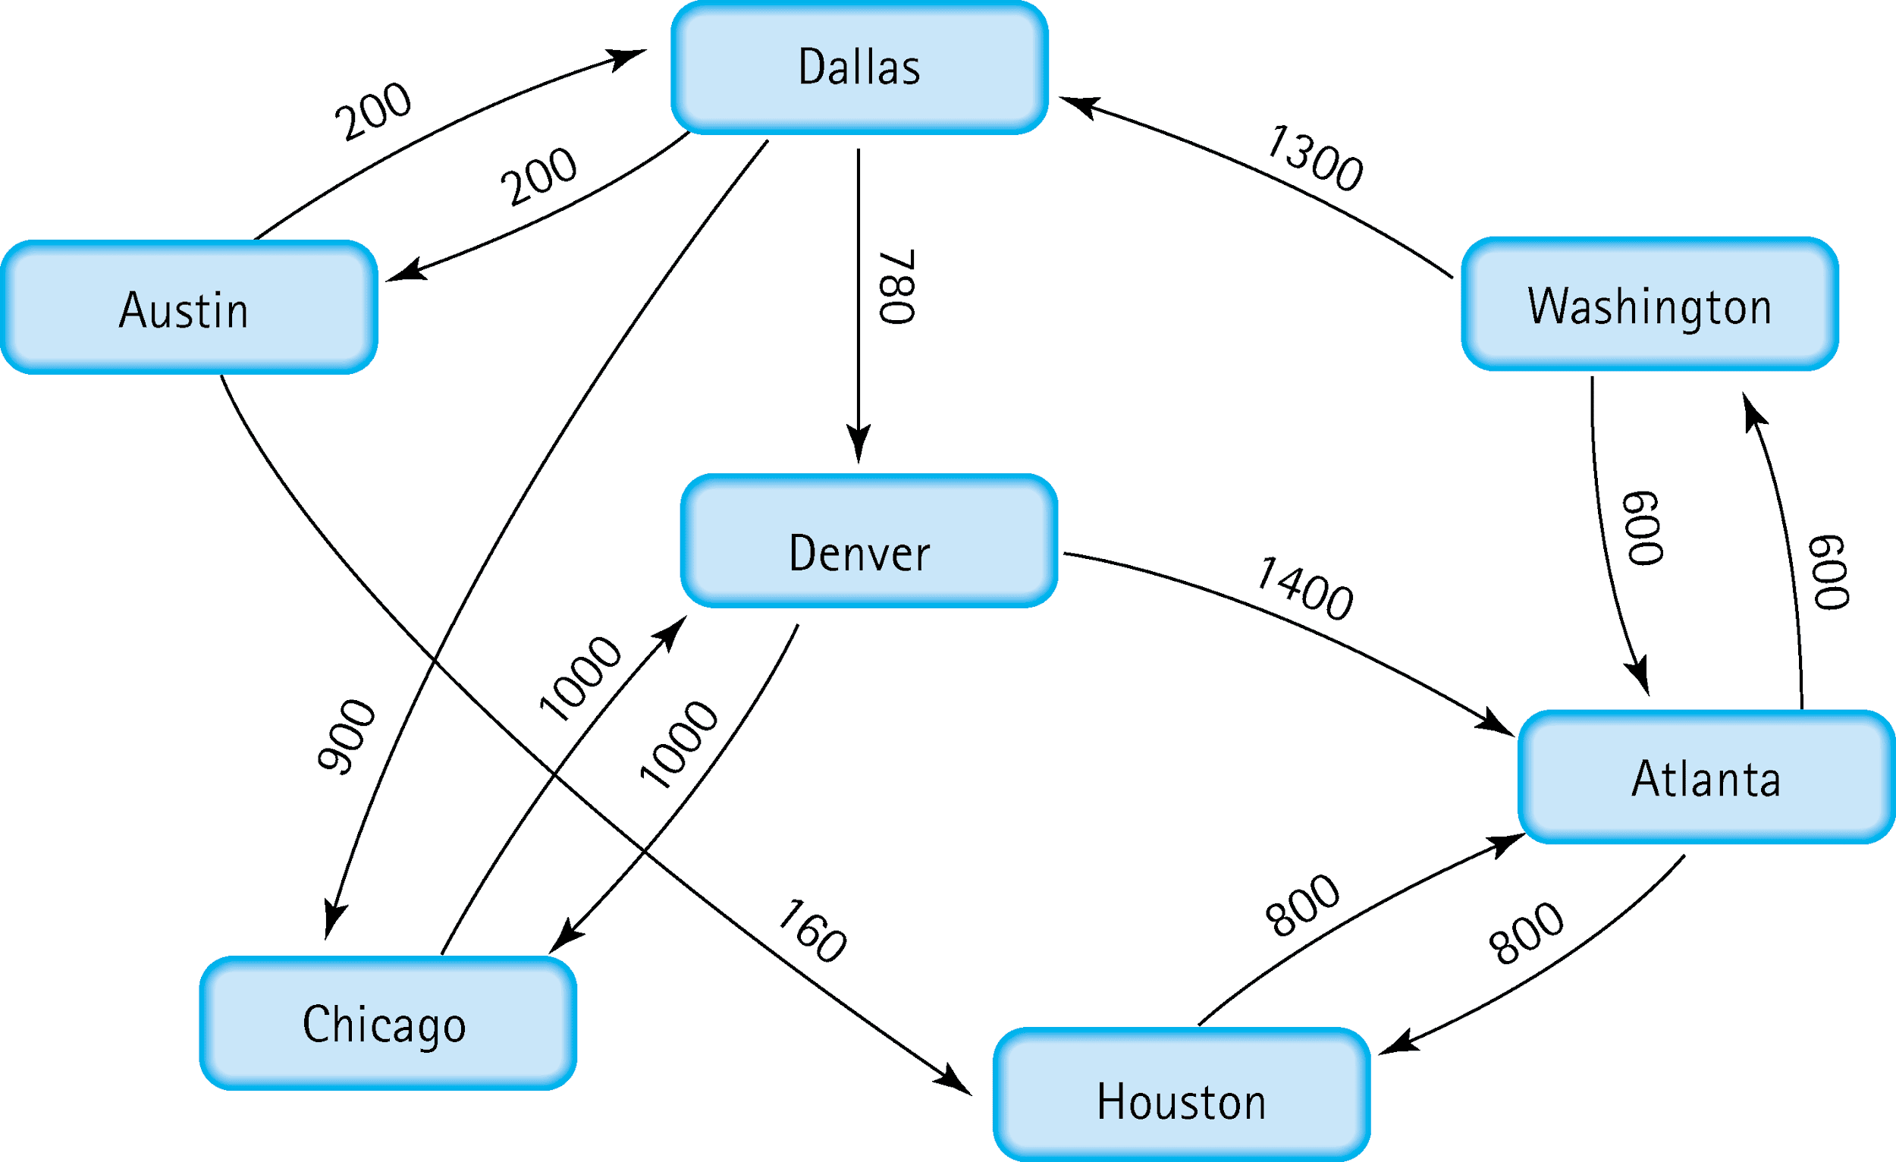
5. Find the shortest distance from Atlanta to every other city
Atlanta to Washington: 600 units
Atlanta to Houston: 800 units
Atlanta to Denver: 600 (Washington) + 1300 (Dallas) + 780 = 2680 units
Atlanta to Chicago: 600 (Washington) + 1300 (Dallas) + 900 = 2800 units
Atlanta to Austin: 600 (Washington) + 1300 (Dallas) + 200 = 2100 units
Atlanta to Dallas: 600 (Washington) + 1300 = 1900 units

Slide 5
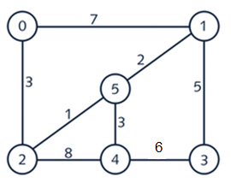

6. Find the minimal spanning tree using Prim’s algorithm. Use
0 as the source vertex . Show the steps.
Steps:
1) We first select (0, 2) because it has a weight of 3 which is less than 7 from (0, 1).
2) We then select (2, 5) because it has a weight of 1 which is less than 8 from (2, 4).
3) We select (5, 1) because it has the smallest weight of 2.
4) We select (5, 4) because it has the smallest weight of 3.
5) We select (1, 3) because it has the smallest weight of 5.
All the vertices are in the tree so we stop here.
Edges:
(0, 2), (2, 5), (5, 1), (5, 4), (1, 3)
Total Weight: 3 + 1 + 2 + 3 + 5 = 14

Slide 6


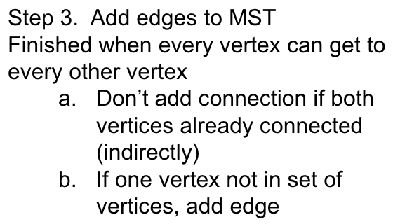
7. Find the minimal spanning tree using Kruskal’s algorithm.
Show the weights in order and the steps.
Steps:
Edges and Weights:
(2, 5): 1
(1, 5): 2
(0, 2): 3
(4, 5): 3
(1, 3): 5
(3, 4): 6
(0, 1): 7
(2, 4): 8
Ordering by weight:
(already done)
Adding edges to MST:
(2, 5) - we have vertices 2, 5
(1, 5) - we have vertices 1, 2, 5
(0, 2) - we have vertices 0, 1, 2, 5
(4, 5) - we have vertices 0, 1, 2, 4, 5
(1, 3) - we have vertices 0, 1, 2, 3, 4, 5 (all vertices)

Slide 7
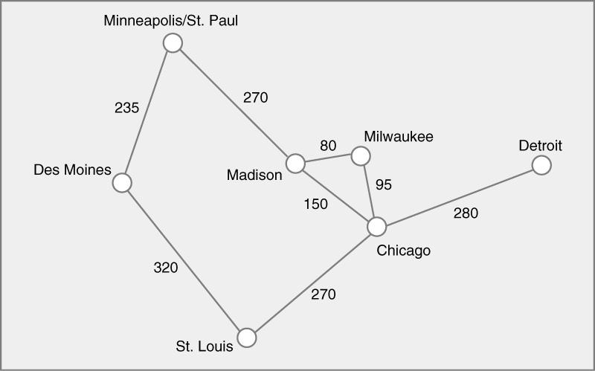
8. Find the minimal spanning tree using the algorithm you prefer. Use
Minneapolis/St. Paul as the source vertex
Steps:
Edges and Weights:
(2, 5): 1
(1, 5): 2
(0, 2): 3
(4, 5): 3
(1, 3): 5
(3, 4): 6
(0, 1): 7
(2, 4): 8
Ordering by weight:
(already done)
Adding edges to MST:
(2, 5) - we have vertices 2, 5
(1, 5) - we have vertices 1, 2, 5
(0, 2) - we have vertices 0, 1, 2, 5
(4, 5) - we have vertices 0, 1, 2, 4, 5
(1, 3) - we have vertices 0, 1, 2, 3, 4, 5 (all vertices)

Slide 8
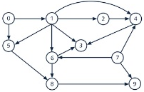
9. List the nodes of the graph in a breadth first topological ordering. Show the
steps using arrays predCount, topologicalOrder and a queue
Steps:
We must find how many directed edges each node has (number of arrows).
predCount Array:
Node | 0 | 1 | 2 | 3 | 4 | 5 | 6 | 7 | 8 | 9
Edges | 0 | 1 | 1 | 3 | 3 | 2 | 2 | 0 | 2 | 2
2) We use the queue to form the topological order, starting with [0, 7] since they have no directed edges currently.
Queue = [0, 7]
The topologicalOrder array is currently empty.
We can start by dequeuing 0 and adding it to the topologicalOrder array. All dequeued values are added to the topologicalOrder array.
predCount[1] becomes 0 and predCount[5] also becomes 1 as a result, so we enqueue 1.
Queue = [7, 1]
After dequeuing 7, predCount[4] becomes 2, predCount[6] becomes 1, and predCount[9] becomes 1. We can’t enqueue any of these right now, so we dequeue 1.
Queue = null
The 3rd, 4th, 5th, 6th, and 7th element predCount become 0, 2, 1, 0, and 0 respectively, so we cna enqueue 2, 5, and 6.
Queue = [2, 6, 5]
After dequeueing 2, predCount[4] becomes 0 so we can enqueue 4.
Queue = [6, 5, 4]
After dequeuing 6, predCount[8] becomes 1 so we can’t enqueue it immediately. We continue by dequeuing 5.
Queue = [4]
This change causes predCount[8] to become 0 so we can now dequeue it.
Queue = [4,8]
After dequeuing 4, predCount[3] becomes 1 so we can’t enqueue it right now. We continue by dequeueing 8.
Queue = []
This causes predCount[3] and predCount[9] to be 0 so we can enqueue 3 and 9. We can immediately dequeue them and this action causes no change to the predCount array so we are done.
Final topologicalOrder array:
Element | 0 | 1 | 2 | 3 | 4 | 5 | 6 | 7 | 8 | 9
Value | 0 | 7 | 1 | 2 | 6 | 5 | 4 | 8 | 3 | 9

Slide 9
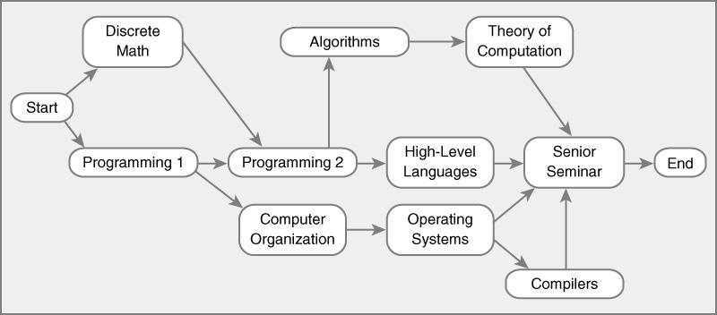
10. List the nodes of the graph in a breadth first topological ordering.
Steps:
We must find how many directed edges each node has (number of arrows).
predCount Array:
Start: 0
Discrete Math: 1
Programming 1: 1
Programming 2: 2
Algorithms: 1
Computer Organization: 1
Theory of Computation: 1
High-Level Languages: 1
Operating Systems: 1
Senior Seminar: 4
Compilers: 1
End: 1
We remove Start and add it to the topological order.
Discrete Math and Programming 1 have 0 edges as a result, so we enqueue those.
After dequeuing Discrete Math, Programming 2 has only one edge, and after removing Programming 1, Programming 2 and Computer Organizations has 0 edges so we enqueue those.
After dequeuing Programming 2, High-Level Languages and Algorithms have no edges so we enqueue those which causes Theory of Computation to be enqueued, and after dequeuing Computer Organizations, Operating Systems has no edges so that is enqueued, as well as Compilers.
After dequeueing High Level Languages, Senior Seminar loses an edge, and after dequeueing Algorithms, Theory of Computation is enqueued which also causes Senior Seminar to lose an edge and be enqueued, which causes “End” to be enqueued.
We can then proceed to dequeue everything, which leads to the following order
Topogical order:
Start
Discrete Math
Programming 1
Programming 2
Computer Organizations
High Level Languages
Algorithms
Operating Systems
Theory of Computation
Senior Seminar
End

